Slide 1
Endpoints Operations
Monthly Operations Summary
JL IT
February 2023

Slide 2
Executive Summary
Incident Management Summary
Service Desk Summary
Technology Operations Summary
Endpoint Engineering Summary

Slide 3
Executive Summary
Incident Management saw incident volume lower in December (2,605). The first call resolution, or FCR, was 85.6%. The overall SLA goal across all teams was not met at 89.2%.
Service Desk call volume dropped to 2169 calls in December. Calls answered within 30-, 60-, and 90- seconds goals were surpassed. Average speed to answer was 35 seconds. The abandonment rate goal for the month was also surpassed at 7.15%. SLA goals were met by the Service Desk with an overall SLA score of 96.9%.
Technology Operations assignment groups opened or received 386 incidents across the month with 46 being escalated to Engineering. Critical Alerts increased from 100 to 209 in January. This was due to Azure VM’s with remaining memory ( being investigated) and Aderant environment reboots. We adjusted some threshold for CPU from known problematic servers and remove UptimeSeconds ( reboot condition). This cause a drop from a 1500 error alerts to 300. Website uptime remains the same, we’re adding more URL to probe and monitor.
Endpoint Engineering Successfully deployed Egress Protect and associated CSPs firmwide. Fine-tuning Egress to better fit our environment for functionality and performance. NetDocs' ndOffice 3.1.0 Suite currently on three fourths of our fleet(1580), up 900+ devices from January. All Users deployment of Litera planned out in February for March 17th release to all users. Continuing to move GPO elements into Intune for less reliance on GPOs. 8x8 Network Utility current in prelim stage. Successfully onboarded remaining MacOS users with Intune-Jamf co-management for conditional access support. Update to our new Citrix workspace app currently being tested for a mid-March release.

Slide 4
Incident Management

Slide 5
Incident Statistics
3,107 incidents were opened during the month, across all groups within SNOW. 19.9% of incident volume was email.
Phone: 2372
Email: 620
Self-Service: 70
Walk-in: 45
Chat: 2
First contact resolution decreased slightly in January to 85.3% (as opposed to 85% in January).

Slide 6
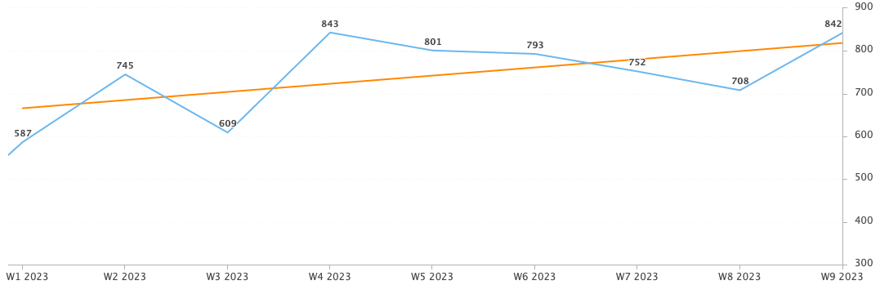
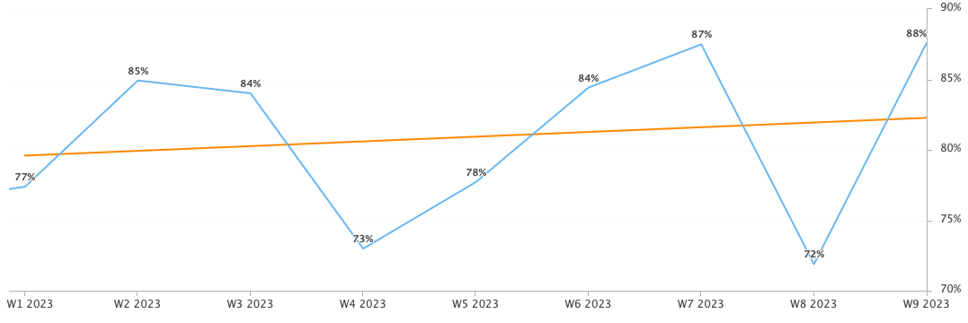
Incident Statistics
Incidents Opened by Week
Incidents opened by week trended upward over the last two months.
The percentage of incidents resolved the same day that they were opened continues to trend upward.
Percentage of incidents resolved; same day opened.

Slide 7
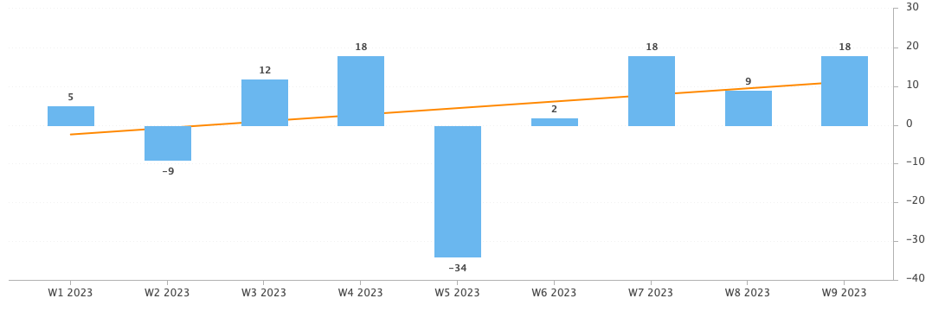
Incident Statistics
Open Incident Backlog Growth
Backlog growth rose across February.
Notes:
Backlog growth is a way of answering, “did we end the week with more or less incidents?”.

Slide 8
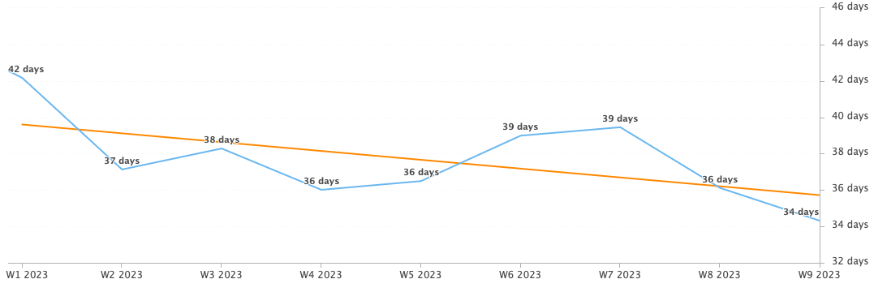
Incident Statistics
Average Age of Open Incidents
In February, the average age of open incidents continued to decline.
Notes:
Please remind your teams to continue to work on their open incidents- this affects many of the previous slides as well as this one.

Slide 9
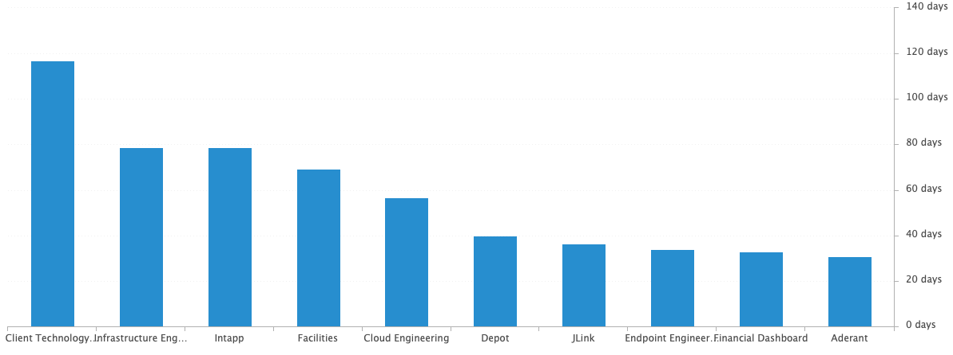
Incident Statistics
Average Age of Open Incidents by Assignment Group - as of the last day of the month

Slide 10
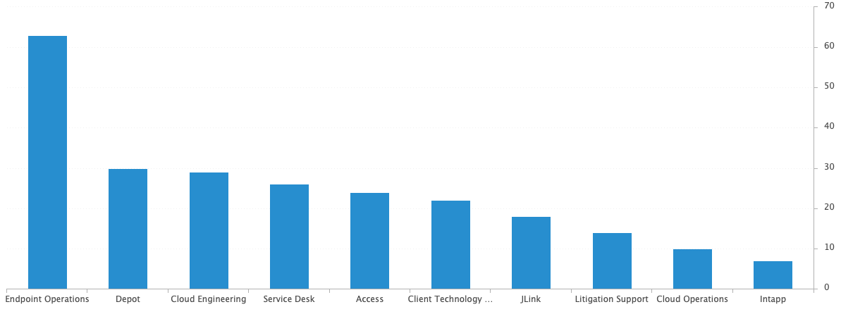
Incident Statistics
Open Incidents by Assignment Group - as of the last day of the month
There are currently 271 open incidents across all teams.

Slide 11
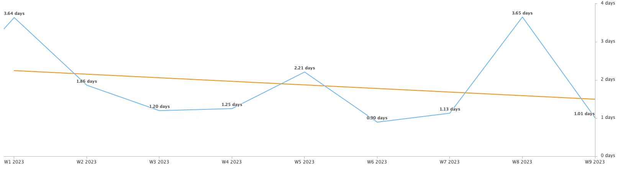
Incident Statistics
Average Resolution Time of All Resolved Incidents
The average resolution time trended downward across the last two months.

Slide 12
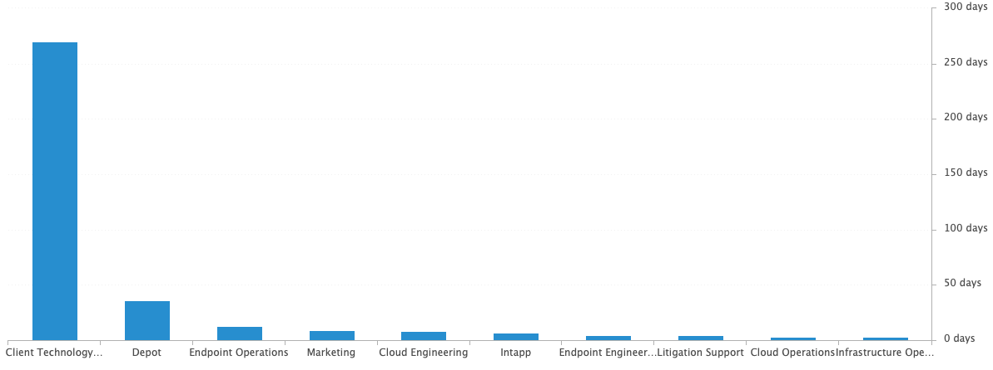
Incident Statistics
Average Resolution Time of Resolved Incidents, by Assignment Group

Slide 13
Incident Statistics
Top 5 Subcategories this month:
Microsoft Office (654)
NetDocuments (404)
Add-ins (182)
Active Directory (126)
Cisco Phone (101)
Top 5 Resolved By this month:
(highest volume of resolved Incidents)
Dan (442)
Chris (323)
Blaise (299)
Brandon (260)
Stephane (257)
Top 5 Assignment Groups (Tier 2) this month:
Endpoint Operations (117)
Cloud Operations (85)
Access (61)
Telco Operations (30)
Infrastructure Operations (12)
Top 5 Assignment Groups (Tier 3) this month:
Cloud Engineering (56)
Security (16)
Aderant (9)
Intapp (8)
Jlink (7)

Slide 14
Incident Statistics
Top 10 Customers this month:
Nancy Batchelder (32) (NH, 1/4/23)
Beth Davis (24)
Carol Garrity (17) (NH, 1/3/23)
Elissa Ali (17)
Rose Senenko (16)
Suddie Scott (16)
Youli Comfort (16) (NH, 1/9/23)
Ann Rake (15)
Denise Schowe (15)
Jing Tong (15)
Notes:
Across the month _had the highest number of related incidents.
Top 5 customers in the month are listed here.
Looking at the chart, we’re tracking incident volume per new-hire per month and comparing this to last year.

Slide 15
2022 SLA Goals & Actuals
Month | January | February | March | April | May | June | July | Aug | Sept | Oct | Nov | Dec
Goal | 90% | 90% | 90% | 90% | 90% | 90% | 90% | 90% | 90% | 90% | 90% | 90%
Actual | 91.9% | 92.38%
SLA score for last year was 90.85%.
The Incident SLA goal was met in February.

Slide 16
Problem Statistics
Open Problems
Problem | Date of most recent update | Assignment Group
PRB0010189 | 2023-01-10 | Cloud Engineering
PRB0010587 | 2023-01-12 | Cloud Engineering
PRB0010598 | 2023-03-02 | Security
PRB0010606 | 2023-03-10 | Endpoint Operations
PRB0010617 | 2023-01-27 | Infrastructure Engineering
PRB0010634 | 2023-03-06 | Endpoint Engineering
PRB0010657 | 2023-03-08 | Cloud Engineering
PRB0010673 | 2023-03-08 | Endpoint Engineering
PRB0010677 | 2023-03-08 | Endpoint Engineering
PRB0010678 | 2023-03-01 | Client Technology
PRB0010679 | 2023-03-10 | Cloud Engineering
PRB0010680 | 2023-03-02 | Cloud Engineering
Did you know?
PRB marked in Red have not been updated within the last month. ->

Slide 17
Service Desk

Slide 18
Year over Year Quarterly Results
Total incident and call volume reduced in Q4 2022 over 2021.

Slide 19
Key Call Statistics
Call volume remained steady from the previous month with 2642 calls in February.
The goal was met with a strong start for the year as it ended with 5.87%.
The abandonment rate monthly goal in 2022 was 9%. We’ve ambitiously lowered the ceiling of the goal to 8% for 2023.
Notes:
~
There are several stats tracked for individual analysts as well as for the team and the org. Across the next few slides I’ll highlight some key statistics for the Service Desk team.

Slide 20
Key Call Statistics
The Service Desk met all 3 goals for each range. This correlates with the call volume and abandonment rates.
The goals for each time period:
70% of calls handled within 30 seconds.
75% of calls handled within 60 seconds.
80% of calls handled within 90 seconds.
Notes:
Over 75% of calls were handled within 30 seconds.
Over 80% were handled within 60 seconds.
Over 83% were handled within 90 seconds.
~
We track multiple metrics for calls handled- or how quickly a call is answered- within specific time periods. I’ve highlighted three here, calls handled within 30, 60, and 90 seconds.
The takeaway from these numbers should be that we are answering calls quickly which prevents calls from abandoning. Typically, we see the abandoned calls rise when these goals are not met- specifically the 60 seconds metric.

Slide 21
Key Call & Knowledge Statistics
The average speed to answer set a new low record at 29 seconds.
Notes:
~
Average speed to answer is the average of how quickly all calls were answered by the Service Desk for the month.

Slide 22
Incident Statistics
Closed Monthly Data:
Incidents closed by SD: 2,491
Total Closed Incidents: 2,979
Closed by SD Percentage: 83.6%
Incidents closed by Service Desk, by Source:
Phone: 2250
Email: 616
Self-Service: 66
Walk-in: 47
Notes:
~
The typical methods for contacting the Service Desk are phone and email, which explains the results in the incident source chart.
Self-Service we hope to expand over the next year and drive users towards generating their own incidents and using the JL Service Center more actively.
Walk-ins are low month-to-month with the split schedule for Return to Better. But from analyst feedback incidents for walk-ins are not being opened consistently. I aim to correct this over the rest of this year. I’ve also added it as a 2022 goal for each analyst within their reviews.

Slide 23

2021 Service Desk SLA Statistics
Survey Response Comment Highlights:
Noah - The technician was very knowledgeable, efficient, helpful and friendly. I'm beyond pleased with the assistance I received. Thank you.
Chris - Amazing service and response. Thank you.
Sandy - The IT team is fantastic. They are very helpful every time I need them.
Taylor – Extremely helpful.
Brandon is an asset on the help desk team. He always knows how to fix the issue and is very pleasant.
Erica - she was thorough and helpful
Thank you Keith and Wolfgang!
Brandon did a great job resolving my issue as usual! Thank you Brandon!
Stephane - I appreciate the Jackson Lewis IT Help Desk. Thank you!
September | Breached | Has not Breached | SLA %
Response | 78 | 2416 | 96.77%
Resolution | 25 | 2469 | 98.98%
Overall | 103 | 4885 | 97.92%
Response & Resolution SLA timers are determined by the Priority of the Incident.
Both Response and Resolution SLA reviewed on this slide are across all Priorities.
Notes:
Service level agreements/SLA
Response & Resolution SLA timers are determined by the Priority of the Incident.
Both Response and Resolution SLA reviewed on this slide are across all Priorities.
~ The Service Desk team is uniquely prepared to meet SLA goals. We generate incidents during calls, while emails generate their own incidents.

Slide 24
Update & Reminder Highlights
Egress: Please remember to pull logs from Egress if you need to escalate an Egress related issue. Steps to do so are within this article.
OA Change: Leslie Luque is no longer the OA for the LA office. Martha Tanner is covering this site for now.
Training check box: Please remember to use the training check box, within Incident.
Litera: Litera’s manual install instructions have been updated.
Escalation Guide: Please remember to follow the escalation guidelines here in knowledge.
JL Collaborate: I’ll update knowledge, but please change both the Notified By and Customer fields to Guest for incidents for external users. This way we’re not bombarding Mark or his team with updates on these incidents.
Typically, this is correct: we want notified by and customer to be accurate. This is just an exception.
Microsoft O365: We’ve taken steps to simplify the process when installing or reinstalling O365. Please follow the steps in this article when it is necessary to reinstall O365.
Litera: Please install Litera for users who reach out to us, regardless of if this has been deployed to their region.
On Call: Beginning next week we will begin to include the cell number of the analyst(s) covering an on-call shift in the weekly email. This is to make it easier for those in IT to quickly reach out for anything urgent.
These updates and more are available here.
Notes:
Some highlights from the month’s U&R emails are listed here.
One to two emails are sent a week to the Service Desk reminding them, or updating them on, changes to existing workflows or policies. Quick notes sent via Teams are also rolled up into these emails to be sure that these points are not missed. All U&R emails are listed in Confluence for reference by other teams.

Slide 25
Technology Operations

Slide 26
Escalation Status

Slide 27
Escalation Baselines

Slide 28
Logic Monitor Alerts
Critical Alerts:
Azure VM’s recorded AvailableMemoryBytes recorded 80 critical alerts
Aderant Environment Reboots
Error Alerts:
CPU Alerts have been SDT for common VM’s - Removed
UptimeSeconds ( Reboot triggered) has been removed
Most errors are from Physical Network Equipment
AvailableMemoryBytes Errors

Slide 29
Resource Uptime
Resource | November | December | January
Aderant | 99.992% | 100% | 100%
Intapp Walls | 100% | 99.996% | 100%
JL - Home | 99.973% | 97.579% | 99.946%
JLink | 99.996% | 100% | 99.983%
NBI | 99.989% | 97.577% | 99.949%
Payments Credit Card | 100% | 100% | 99.998%
Dashboard | 100% | 99.997% | 99.995%
Biscom | 100% | 99.958% | 100%
Citrix | 100% | 99.964% | 100%
VPN East | 100% | 99.96% | 100%
VPN West | 100% | 100% | 99.985%
Logic Monitor Collector Polling
Improvements hitting 100% with some websites
NBI blimps of errors status code
JL – Home – Authorize timeout during 12/11 5pm EST to 12/12 7am EST

Slide 30
Endpoint Engineering

Slide 31
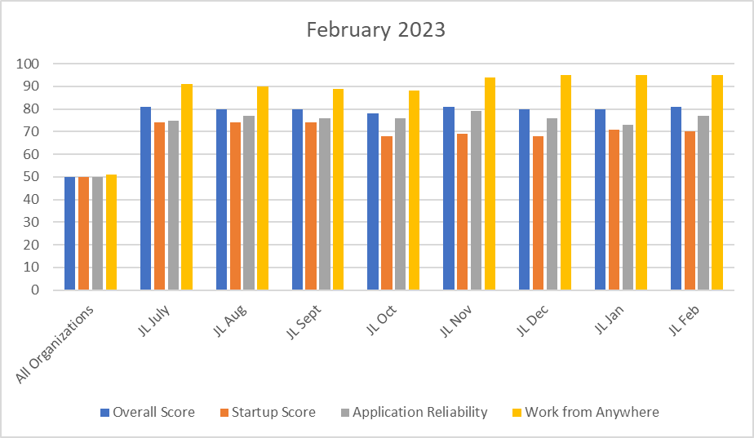
Endpoint Analytics
Overall score rose to 83(+3) from January primarily due to increased numbers of Feature Update 22H2 out to our fleet.
App Reliability score rose 77(+4) primarily due to completion of multiple firmwide app deployments: (Egress, ndOffice 310 at 75% compliance) in February, utlizing updated versions of primary apps, increasing device performance.

Slide 32
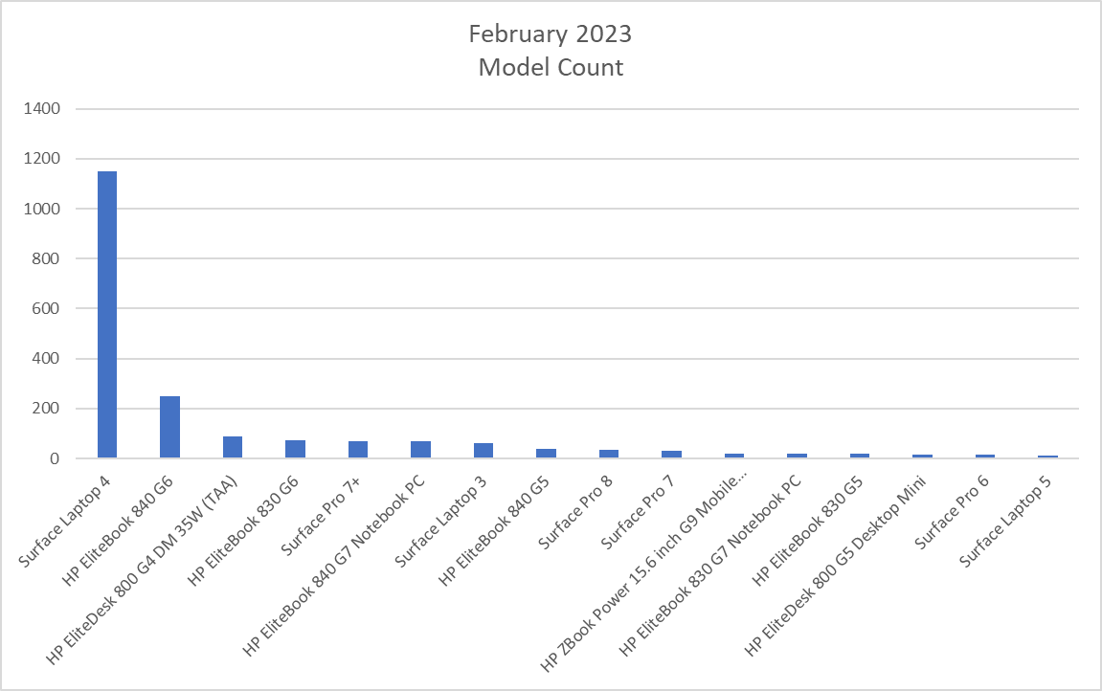
Endpoint Model Inventory
1126 (+50)total Surface Laptop 4s – Best overall performer.
Surface Pro 6 (14 remaining) - Worst performer.
Surface Pro 5's have removed completely.

Slide 33
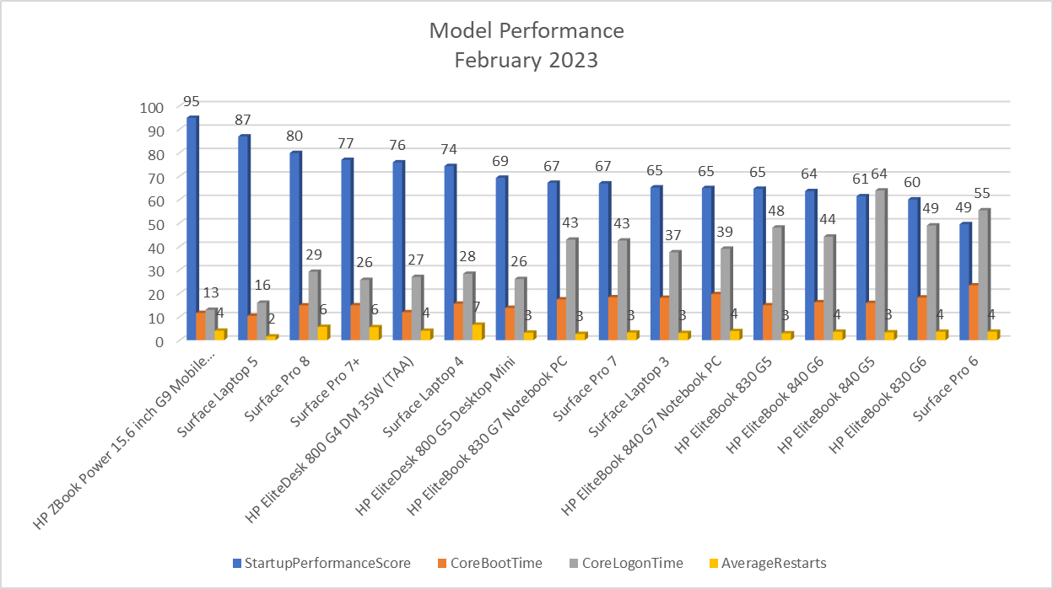
Endpoint Model Performance
Continuing the trend of replacing older hardware with newer models, scores in Startup, Boot, logon and restarts steadily improve.
Our worst performers, HP Elitebook G5s with only 42 units remaining(-38 from January) currently being replaced with SLT4/5's by NextGen.

